Slide 1
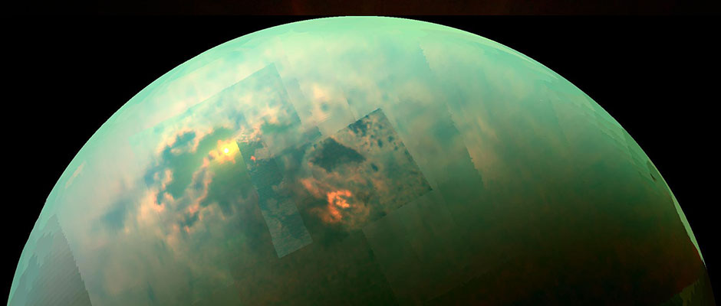
Titan’s variable ionosphere during the T118-T119 flybys
Niklas Edberg, E. Vigren, D. Snowden, L. H. Regoli, O. Shebanits, J.-E. Wahlund, D. J. Andrews, C. Bertucci, J. Cui

Slide 2
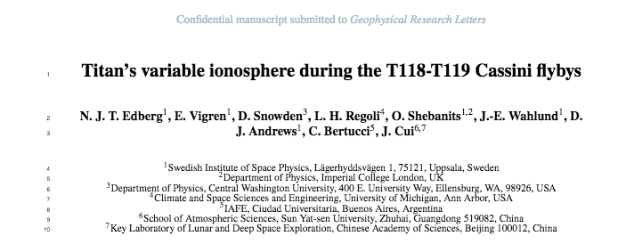
Unusually large difference in density, up to factor of 6
Density during T118 exceptionally low, T119 rather normal
Difference present both inbound and inbound
Two large electron density peaks during T118
Submitted paper is a case study which discusses these observations in the context of what is known to control the ionosphere of Titan

Slide 3
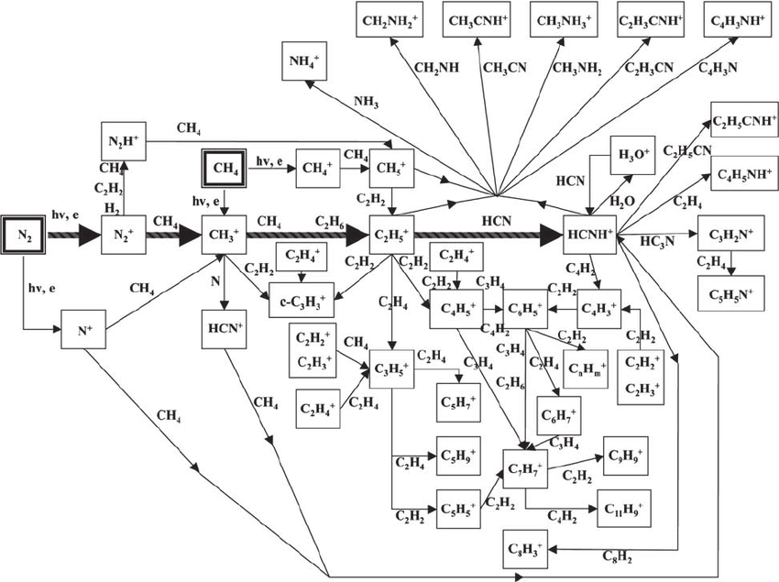
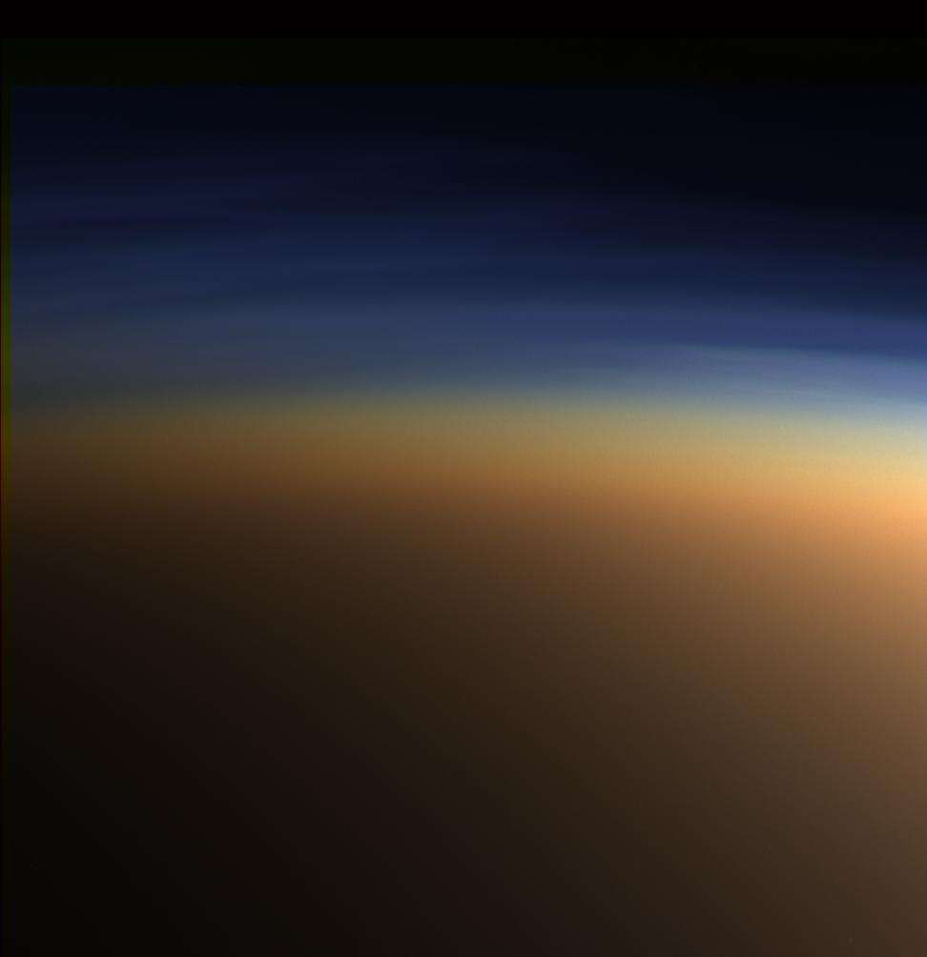
Titan’s ionosphere
Atmosphere of mainly N₂ and CH₄
Sources and sinks of ionosphere:
Dayside: photo-ionisation and impact ionisation from magnetospheric particles, and secondary electrons and transport above ~1400 km
Nightside: impact ionisation and transport from dayside
Electron dissociative recombination
Ion-neutral chemistry
Chemistry subsequently creates a wealth of different, heavy species
Attachment of electrons on dust and heavier particles
HCNH⁺ and N₂⁺ most abundant ions
Chemically and dynamically (one of the) most complex in the solar system
Hydrocarbon rich, heavy organic, positive and negative, molecular ions – factory for Titan’s haze
Conditions similar to Earth before life evolved here
Shebanits, 2017 PhD thesis (adapted after Waite et al., 2007)

Slide 4
Titan’s ionosphere
Some properties of the ionosphere:
Altitude range: ~500-2500 km (R_{T}=2575 km)
Ionospheric peak at 950-1250 km
Peak density of 500-4300 cm⁻³
Electron temperature of ~0.05 eV at the peak
(Some) variable factors controlling the ionosphere:
EUV and X-ray irradiance (0.1-100 nm)
  solar cycle
  SZA
  distance to the Sun
Magnetospheric conditions
  lobe/sheet/other
  ion and electron energy and flux
  Saturn local time
  magnetic field orientation
Neutral atmospheric background
  density and composition
  gravity waves
  neutral winds – dawn/dusk
Electron density maps
Edberg et al., 2015

Slide 5
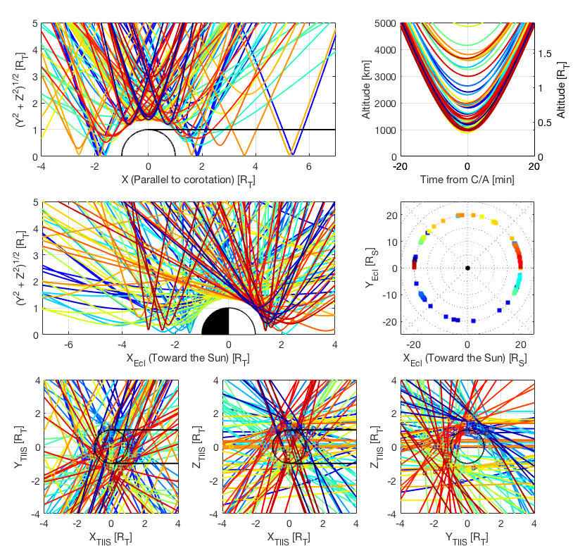
Cassini measurements
127 flybys by Cassini over 13 years
Quite diverse flyby geometry wrt. ram/wake, day/nightside, C/A, Saturn Local time, SZA profile
~1/3 of a Saturn year, more than solar cycle: solar EUV conditions have varied, R_{sun} = 9-10 AU.
RPWS/LP (and MAG) measurements from most of these
CAPS from ~first half of mission

Slide 6
Solar cycle dependence
Measurements from more than a solar cycle
Peak density increases with decreasing SZA
Altitude of ionospheric peak varies with solar cycle and SZA
Edberg et al., 2013

Slide 7
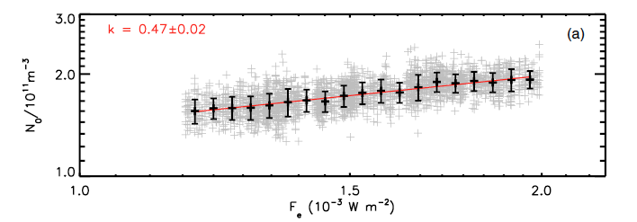
EUV dependence
Mars: Girazian and Withers, 2013, GRL
According to Chapman theory the density N_{e} ∝ F_{e}^{k}, where F_{e} is the ionising flux and k=0.5. We get 0.54.
Data normalized to a common SZA
Several assumptions violated: plane stratified ionosphere, monochromatic radiation, single neutral, a single ion species absorbing the flux, isothermal ionosphere.
Similar to Mars (k=0.47) (Girazian and Withers, 2013)
During previous solar max the peak density at Titan could have been as high as 6500 cm⁻³
Edberg et al., 2013

Slide 8
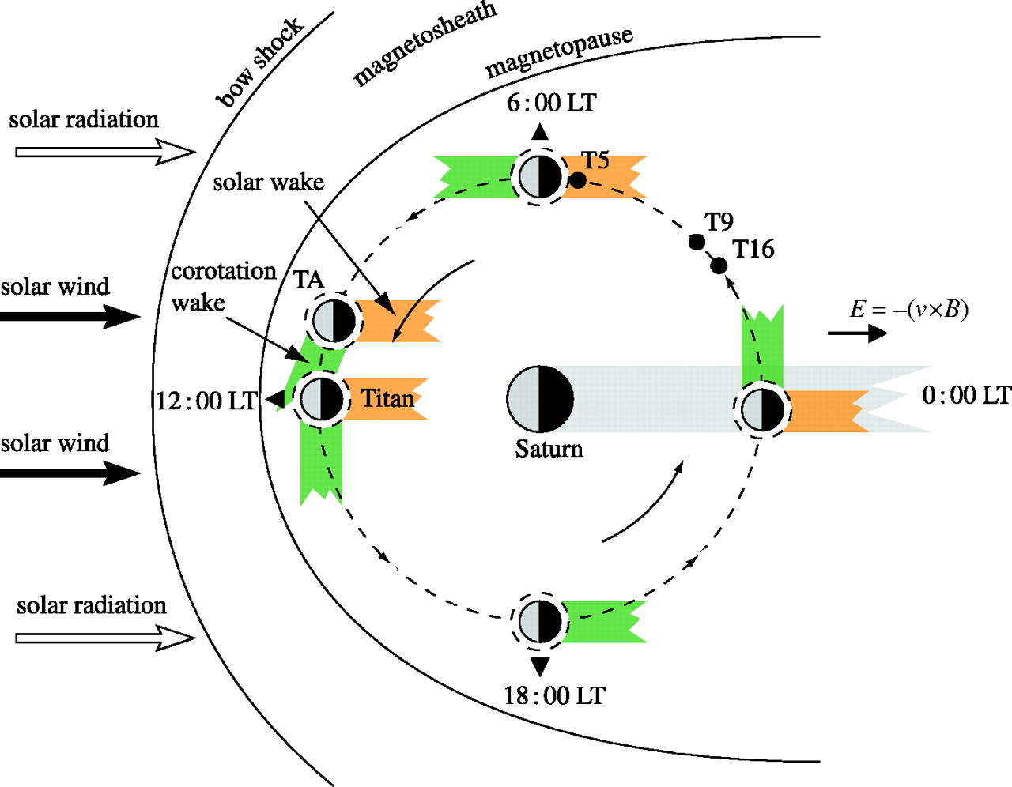
Saturn Local Time dependence
The angle between the wake and the Sun direction varies
Off by 70 degrees at 02 h SLT
Day-to-night transport (Cui et al., 2009, Cravens et al., 2010), and magnetic ram flow are usually not in the same direction
Topside ionosphere, above ~1300-1400 km, is transport dominated while peak region is in more photochemical equilibrium, on the dayside - interesting dynamics in transition region
Affects transport, magnetic draping, precipitation pattern and impact ionisation is affected
Coates et al., 2012

Slide 9
Saturn Local Time dependence
In Saturn-centred coordinate system (figure below):
Higher density when Titan is on Saturn’s nightside than when on dayside – higher dynamic pressure on Saturn’s dayside?
After corrected for EUV dependence
In Titan-centred coordinate systems (left figure):
Statistically, there is higher plasma density in the wake at high altitudes, and higher on the dayside for low altitudes – magnetospheric ram forcing
Ram
Wake
Night
Day
Edberg et al., 2015

Slide 10
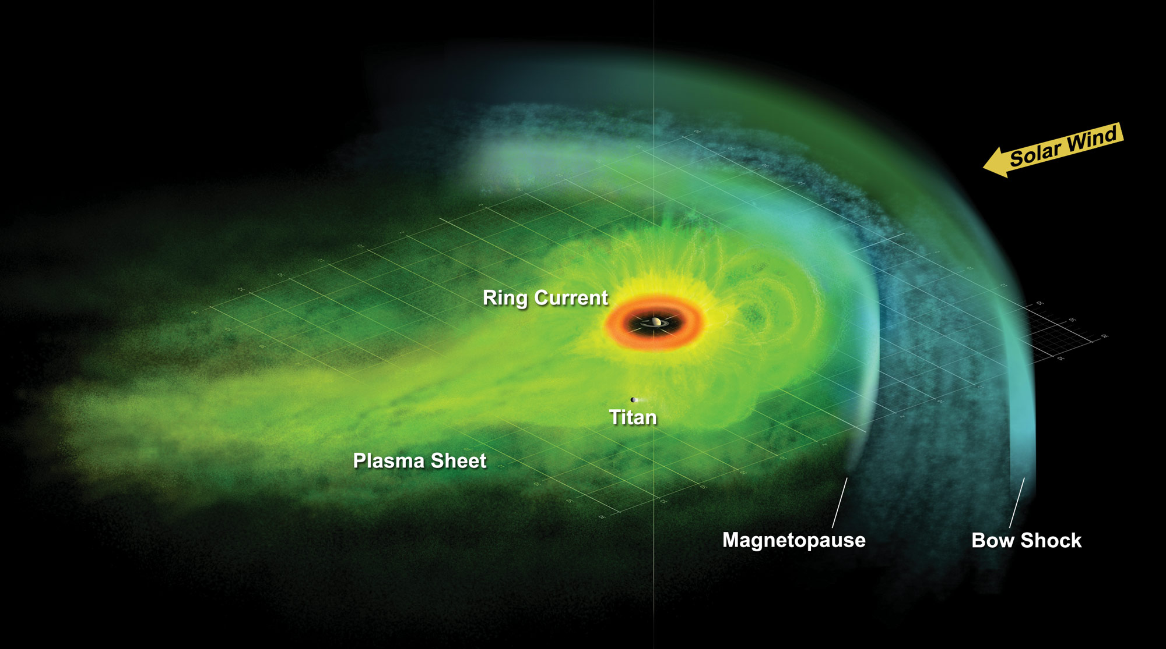
Magnetospheric dependence
Titan orbits at ~20 R_{S} - close to magnetopause (and bow shock) on Saturn’s dayside
Titan is also exposed to a flapping plasma sheet such that it is either in the sheet (high fluxes of particles) or in the northern or southern magnetospheric lobe (low fluxes)
Classification of flybys depending on ambient conditions: e.g. Rymer et al., 2009, Simon et al., 2010,2013; Kabanovic et al., 2017)
Observed in magnetosheath or solar wind during T32, T42, T85, T116 (T94, T97) (e.g. Bertucci et al., 2008, 2015, Wei et a., 2011, Edberg et al., 2015
Edberg et al., 2015
Statistically, we do see higher ionospheric density when Titan is in sheet or in changing/oscillating sheet, than when in the lobes.

Slide 11
Knowing all about what affects the ionosphere of Titan, can we explain the observations during T118 & T119?
Large difference in density, up to factor of 6
Difference present both inbound and inbound
Density during T118 exceptionally low, T119 rather normal
Two large electron density peaks during T118

Slide 12
The T118 and T119 flybys
Similar flybys
Nightside passes (02h SLT )
Main difference in ram/wake
SZA ranges from ~90-180
1 month apart April vs. May 2016
T119 in Saturn’s northern lobe
T118 in Saturn’s northern lobe but with some sheet fluctuations
Nightside
Dayside
Ram
Wake

Slide 13
Cassini RPWS/LP, MAG,
MIMI/CHEMS/LEMMS measurements
[cm⁻²keV⁻¹sr⁻⁻¹s⁻¹]

Slide 14
EUV dependence
Similar orbit and similar SZA profile
Mainly nightside flybys where transport and impact ionisation are the dominant processes
Solar EUV flux very similar during the two passes, as measured by SDO (1 month apart so facing the same solar side)
No solar flare (from Earth based observations)
EUV changes and SZA profile changes are not causing the changes

Slide 15
Magnetospheric dependence
No measurements of 0.1-10 keV particle (CAPS off) but energetic electron flux is lower during T118, could indicate lower impact ionisation
T118 and T119 both in northern lobe of Saturn (Kabanovic et al., 2017) but with some sheet signature during T118
Very similar ambient magnetic field, both inbound and outbound
Some difference in draping around C/A, perhaps due to slightly different ram/wake profile. Not clear that this is enough to cause a factor of 2-6 difference
High energy particle pressure higher during T118 inbound than T119 – some additional pressure on the high altitude ionosphere
Flapping sheet able to explain the peaks at 1150 km and 1200 km?
Angle between Ram flow and Sun direction– could cause “some interesting effects around 1300 km” (Cravens et al., 2010), where transition from the transport controlled starts.
Inbound Outbound

Slide 16
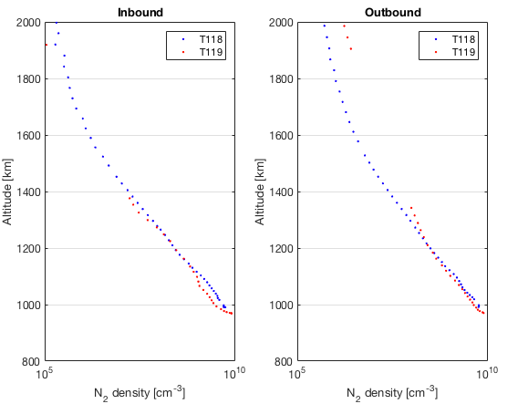
Neutral N₂ profiles
Density overall quite similar
Below 1100 km: higher during T118 inbound, but T118 had lower electron density
Data gap outbound

Slide 17
Gravity waves?
Gravity waves are quite common at Titan (Muller-Wodarg et al., 2006, Cui et al., 2014), wavelength of ~ 100 km, density and pressure changes of ~10%
Some correlation appears to be present, but not enough to explain all features in the ionosphere – something to study in the future perhaps?

Slide 18
Ions, negative ions and dust?
No ion or charge density increase when the electron density is low. Higher ion density during T119 than during T118,which is the same as electron density. So no effect of electrons attaching to dust or heavy ions.

Slide 19
Conclusions
We observe (surprisingly) large variability in the ionospheric electron density during T118 and T119 despite similar orbit, EUV flux, ambient conditions, neutral background, electron temperature
Cause of the difference probably a combination of effects, such as varying impact ionisation, dynamics due to both gravity waves and ram/sun direction difference.
It is important to know all controlling factors when studying Titan flybys!
T118 and T119 is an interesting challenge for modellers!
Not responsible
Trajectory
Saturn Local Time
EUV flux
SZA profile
Solar Flare
Temperature
Neutral background
Dust
Possibly responsible for N_{e}-difference
Magnetospheric particle flux & impact ionisation (most likely anyway)
Possibly responsible for N_{e}- peaks
Magnetospheric particle flux & impact ionisation
Gravity waves?
Ram/Sun direction offset?

