Slide 1

Dusty plasma near Enceladus South Pole
M. Shafiq, M. W. Morooka and J.-E. Wahlund
Swedish Institute of Space Physics, Uppsala, Sweden

Slide 2
Outline
Enceladus and the E ring connection
Overview of recent Enceladus flybys
Plasma parameters inferred from LP data for
E3 flyby
Estimated dust parameters
Behaviour of small vs large grains
Summary and conclusions

Slide 3
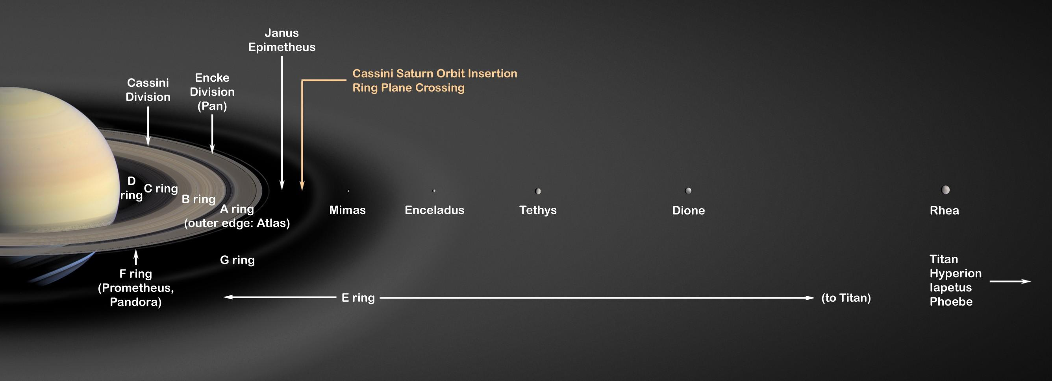
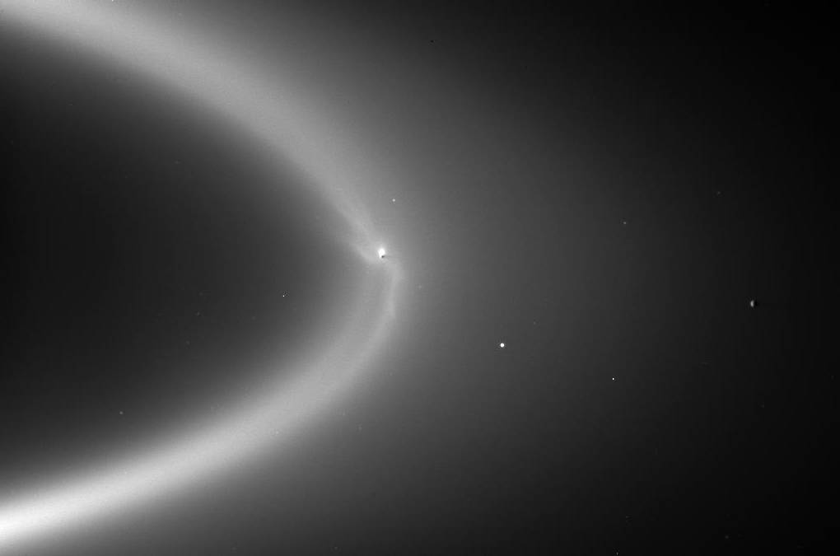
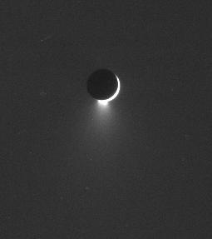
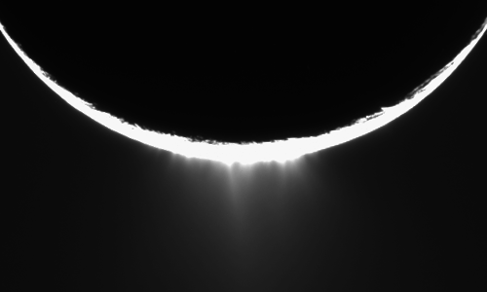
Enceladus

Slide 4
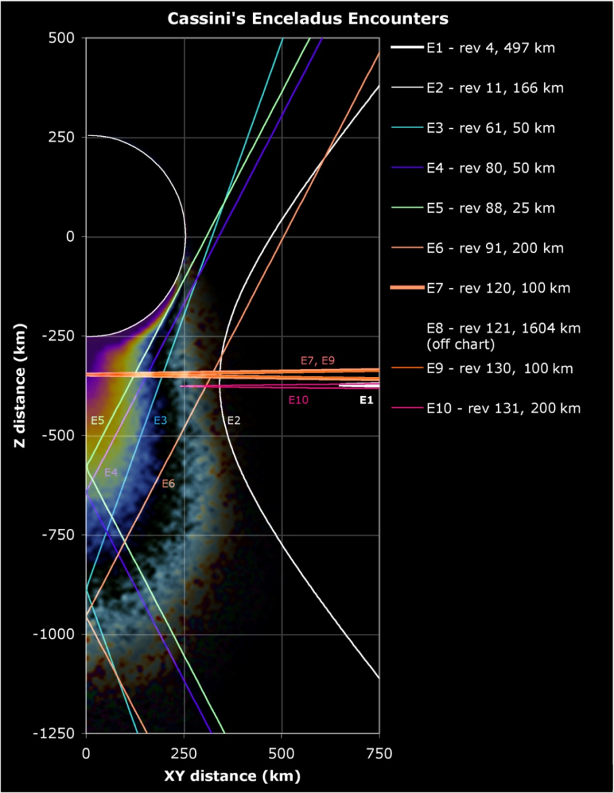
Overview of Recent Enceladus flybys
Rev 11 (E2): 14 July 2005
closest approach=168 km
Rev 61 (E3): 12 Mar 2008
closest approach=52 km
Rev 80 (E4): 11 Aug 2008
closest approach=50 km
Rev 88 (E5): 9 Oct 2008
closest approach=25 km
Rev 91 (E6): 31 Oct 2008
closest approach=200 km
Rev 120 (E07): 11 Nov 2009 closest approach=99 km
Rev 121 (E08): 21 Nov 2009
closest approach=1603 km

Slide 5
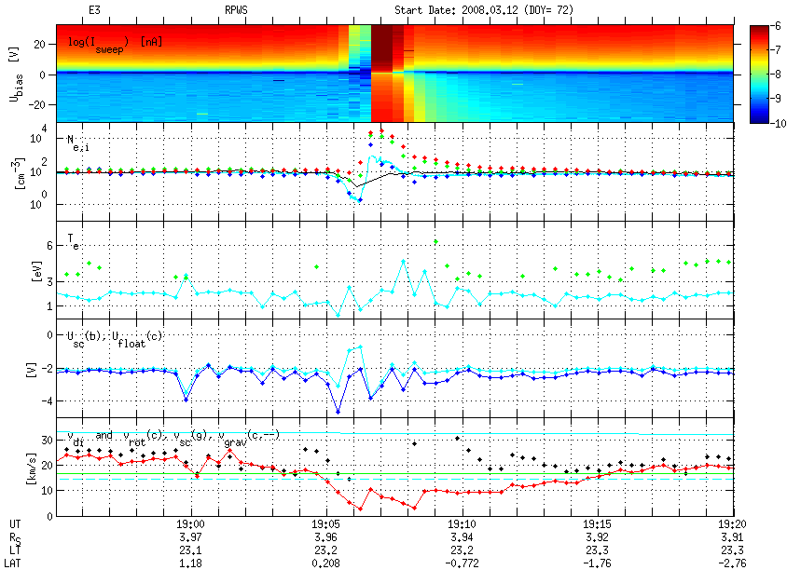
Plasma parameters
NeǂNi
Ne=Ni
Ne=Ni

Slide 6
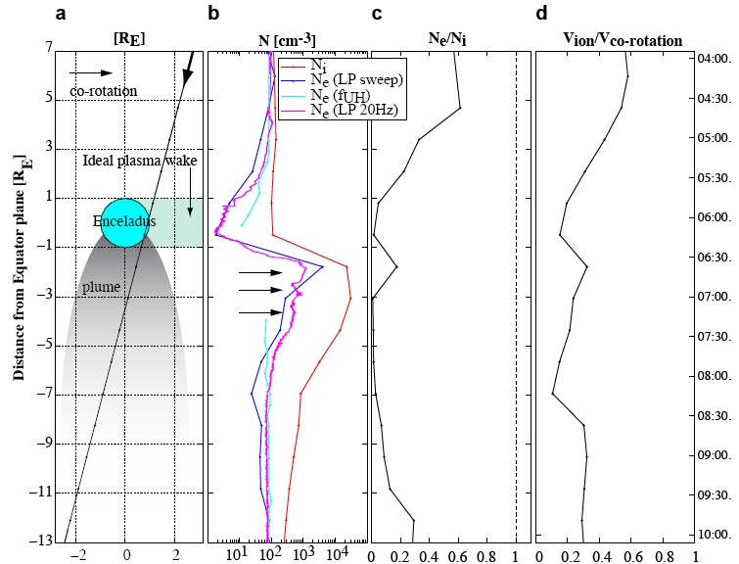
Plasma parameters-contd
From Morooka et al., 2010

Slide 7
Dust parameters for E3

Slide 8
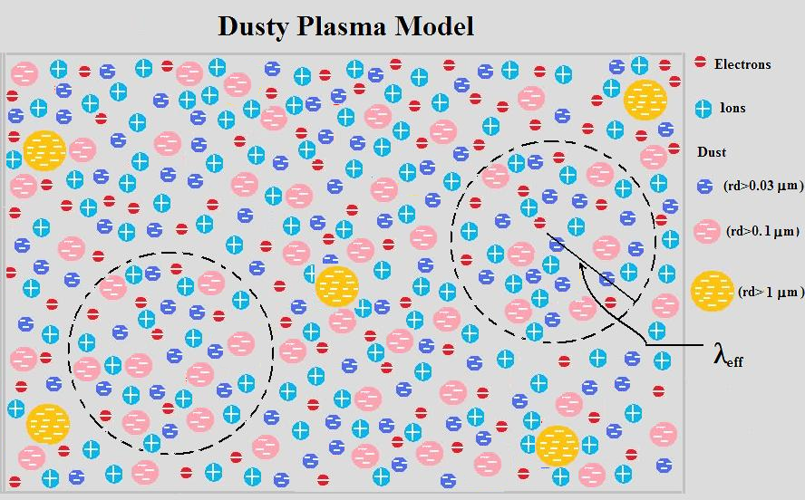
Dust parameters for E3

Slide 9
Summary
Enormous increase in electron and ion currents and
densities is observed for the E ring crossing close to
Enceladus.
Significant difference (up to 2 orders of magnitude)
between electron and ion densities observed near
Enceladus plume with n_{e}<<n_{i}
Dust density of up to 1 particles/cm³ is found in the E-
ring increasing to about 10 particles/cm³ in the
Enceladus plume

Slide 10
Summary-continued
The effective dusty plasma Debye length is found to be larger than the inter-grain distance for sumicron sized grains such that rg<<λD, meaning that the samller grains are taking part in the collective dusty plasma dynamics. The intergrain distance for micrometer sized grains however is larger than the effective dusty plasma Debye length indicating that they are acting as isolated individual grains
The dust charging time is estimated to be around few minute to about 1 hour in the E-ring and is only few seconds in the plume. This indicates the presence of very dense plasma in the plume.

Slide 11
There is aposter by M. W. Morooka on the same topic in the afternoon

Slide 12
Thank you for your
ATTENTION

